Slide 1
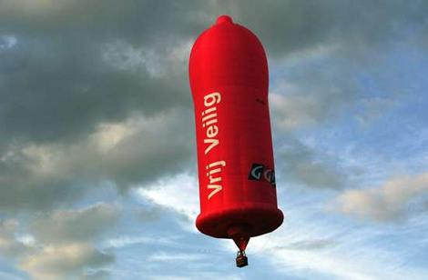

Slide 2
Means of prevention
Risk elimination model - Abstinence
Risk reduction model – Condom use
Harm reduction model – Needle exchange, substitution therapy

Slide 3
Male Condom

Slide 4
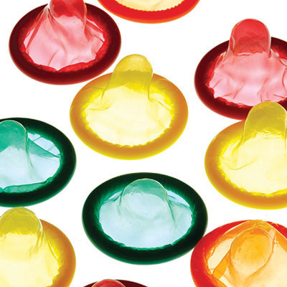

Slide 5
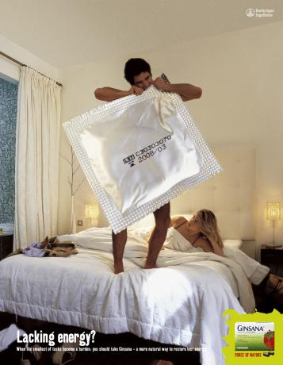

Slide 6
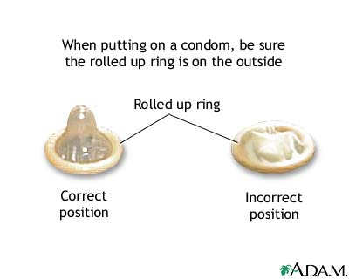

Slide 7
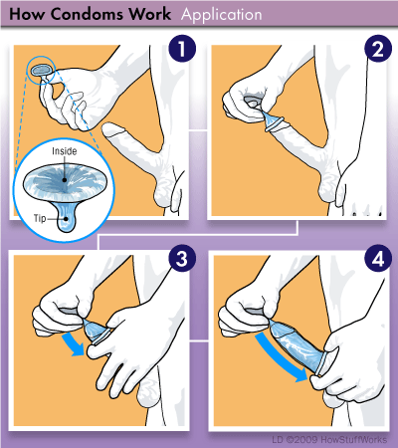

Slide 8
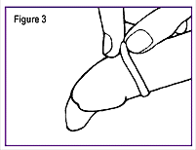

Slide 9
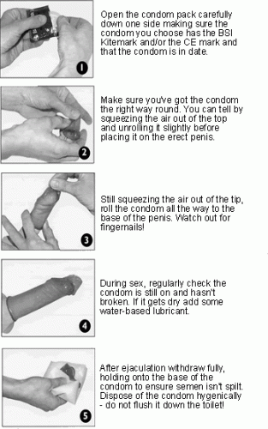
How to use the condom

Slide 10
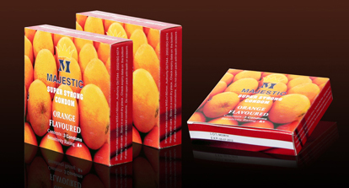
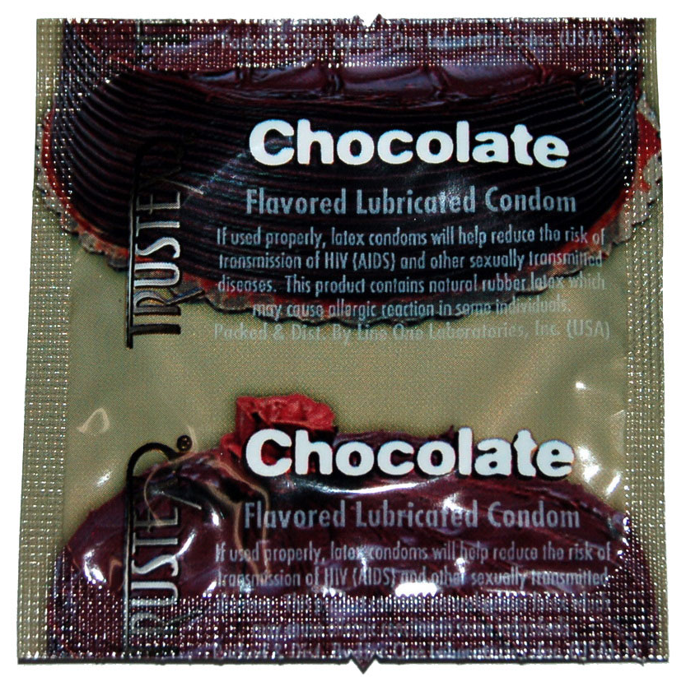
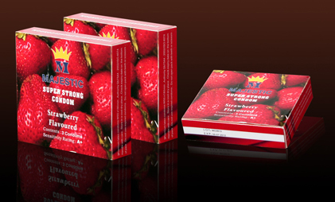
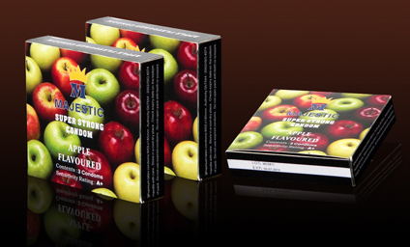

Slide 11
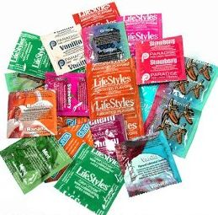

Slide 12
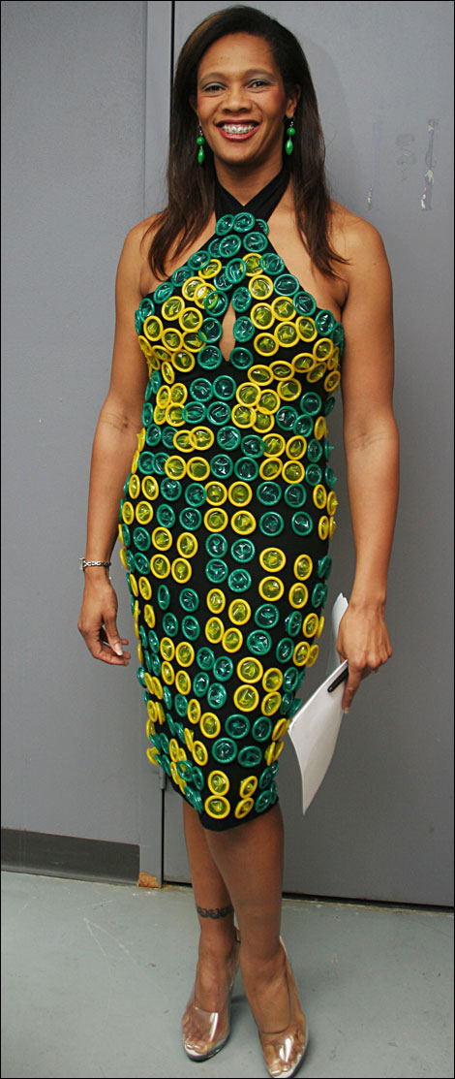
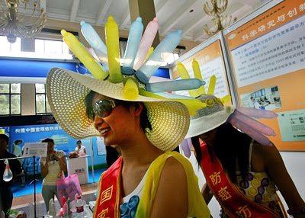
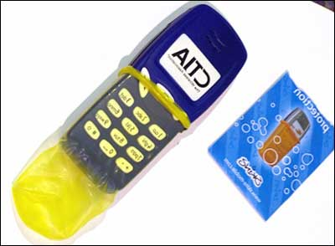

Slide 13
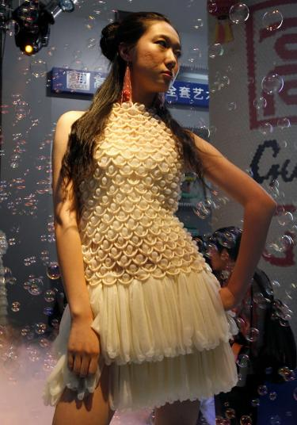


Slide 14
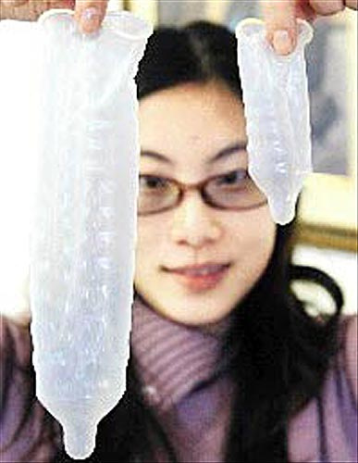
Size

Slide 15
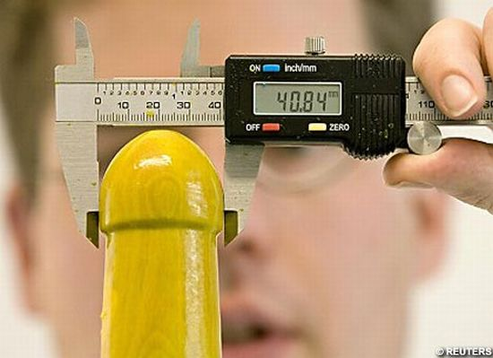

Slide 16
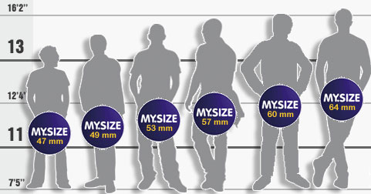

Slide 17
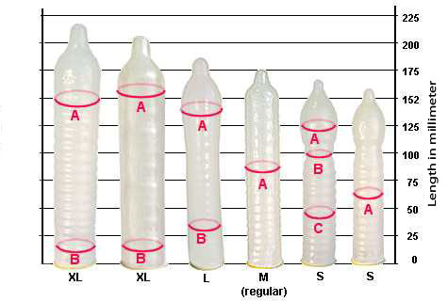

Slide 18
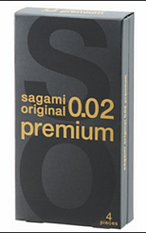
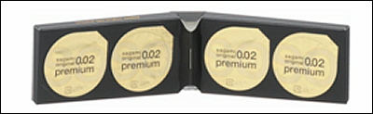
World’s most expensive condoms released on Valentine’s Day
brand polyurethane condoms, which achieved toughness (three times higher bursting pressure and two times higher tensile strength than normal latex condoms) and thinness (world's thinnest 0.02mm) at the same time. "Premium" gained even more softness and flexibility than its predecessors.
This time Sagami Rubber Industries, the first condom manufacturer in Japan and Okamoto's archrival, is introducing a luxury brand of condom "Sagami Original 0.02 Premium". According to Sagami it would be the thinnest and most expensive condom in the world, to be released on no other than the Valentine's Day.
Released on Feb. 14th at the price of 2100 yen (approx. 23 USD, including tax) for a 4pcs box

Slide 19
Female Condom

Slide 20
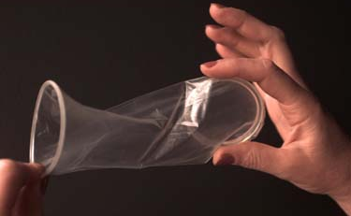

Slide 21
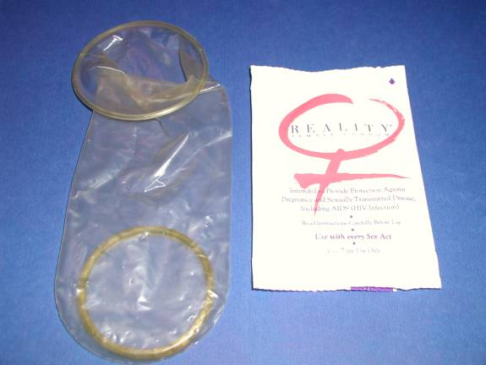

Slide 22
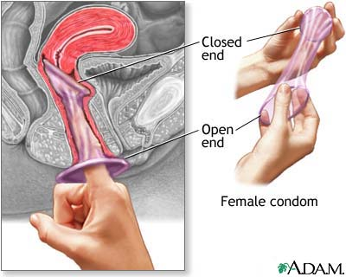

Slide 23
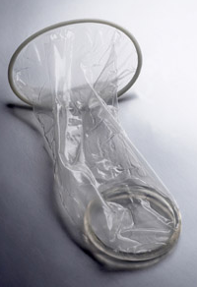
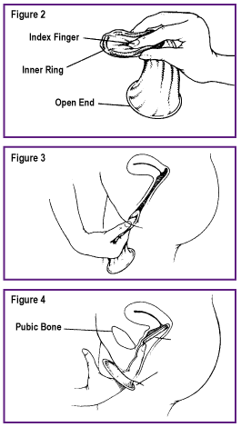

Slide 24
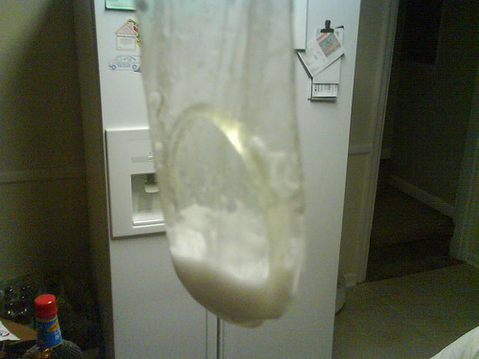

Slide 25
Hotlines
011-2-695-420 (F)
011-2-695-430 (M)

Slide 26
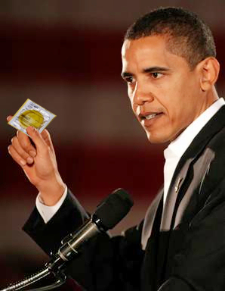
Protect yourself
Use a condom

Slide 27
Quality Control

Slide 28
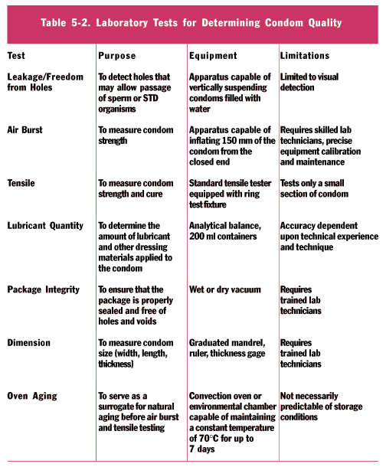

Slide 29
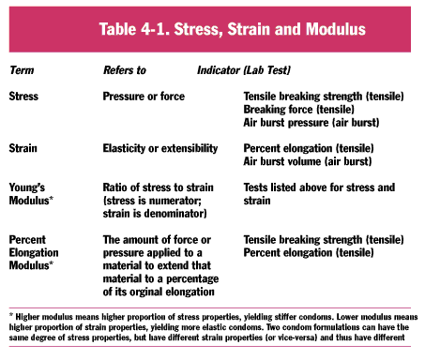

Slide 30
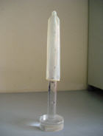
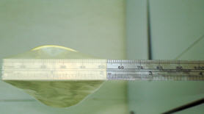
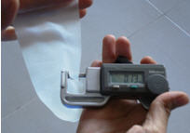
Length
Width
Thickness
The width is measured at a right angle to the length of the condom, when it is unrolled and laid flat without any creases.
Typically, three thickness measurements are made for each sample condom, and an average is determined. In this test the lubricant is removed first; prior tests.
To measure length, the condom is stretched slightly (5 percent to 10 percent) to smooth out wrinkles caused by having been rolled up and then hung over a graduated mandrel.

Slide 31
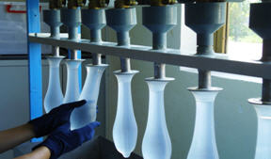
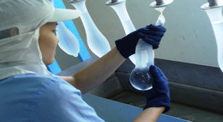
Leakage ("Freedom from Holes“)
In the hang method, the condom is filled with 300 ml water, usually while hanging vertically, and a technician observes for leaks. In the hang/roll approach, a technician takes the water-filled condom from the hanging position, ties the end, and rolls it across an absorbent paper looking for water on the paper. By applying hand rolling method, the test operator can apply equal pressure across the condom during the rolling process, so that the entire condom surface touches the paper.

Slide 32
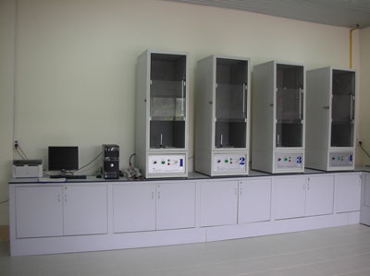
Air Burst
The test inflates the condom like a balloon and measures the volume of air and air pressure needed to burst it. A technician unrolls the condom manually and clamps it on a stem, leaving about 150 mm to be inflated. The apparatus should inflate the condom with clean, oil-free and moisture-free air at a specified rate. The data of burst volume & pressure of each condom tested is automatically recorded by the computer.

Slide 33
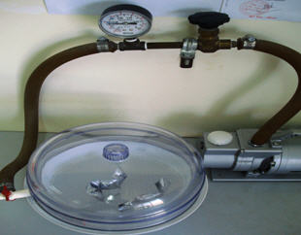
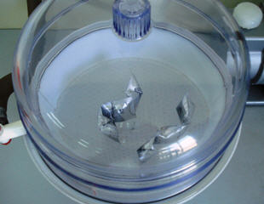
Package Integrity
A packaged condom is put in a dry vacuum decicator for one minute; the package should inflate and remain inflated to pass the test.

Slide 34
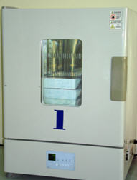
Oven test
Lubricant Quantity
To determine the amount of lubricant used in a pre-lubricated condom, the test measures separately and in various combinations the weight of the packaged condom, the condom with lubricant, the lubricant on the condom, the lubricant in the package, the cleaned condom and the cleaned package.
Seeking to simulate the aging process, the test is intended to provide some indication of how stable the product will be after being stored. After being artificially aged in an oven at an elevated temperature of 70 C for a designated period of time, the air burst tests are performed. Results are compared with the base-line data to determine product deterioration.

