Slide 1
OVERVIEW OF HIV/STIs
IN SRI LANKA, 2000 - 2009
K. A. M. Ariyaratne, MD
Consultant Venereologist

Slide 2
HIV EPIDEMIC IN SRI LANKA
1987
First Sri Lankan with HIV reported
1989
First locally acquired HIV infection

Slide 3
HIV ESTIMATES FOR SRI LANKA
AS OF END 2009
Adults (>15 years) living with HIV - 3000
Children (< 15 years ) living with HIV - 35
Adult HIV prevalence (%) < 0.1 % (0.02%)

Slide 4
HIV ESTIMATES FOR SRI LANKA
Estimated number
Year of Estimate

Slide 5
HIV ESTIMATIONS DONE IN 2009

Slide 6
HIGH-RISK POPULATIONS FOR HIV
Sex workers
IV drug users
MSM

Slide 7
VULNERABLE POPULATIONS
Clients of sex workers
Drug users
Prisoners
Migrant workers
Internally displaced persons (IDP)

Slide 8
DRAFT NATIONAL ESTIMATES
FSW – 41,000
(35,000 - 47,000)
MSM – 31,000
(24,000-37,000)

Slide 9
NATIONAL ESTIMATES
Drug users – 45,000
IDU – 900
(2% of Drug users)

Slide 10
NATIONAL ESTIMATES
Clients of Sex workers 261,000
3.5% of Adult males
(Based on BSS 2007)

Slide 11
TRENDS OF HIV PREVALENCE AND INCIDENCE
EPP (Estimation and Projection Package)
Spectrum models
International and National consultants
Epidemiological assumptions and output estimates were endorsed by stakeholders

Slide 12
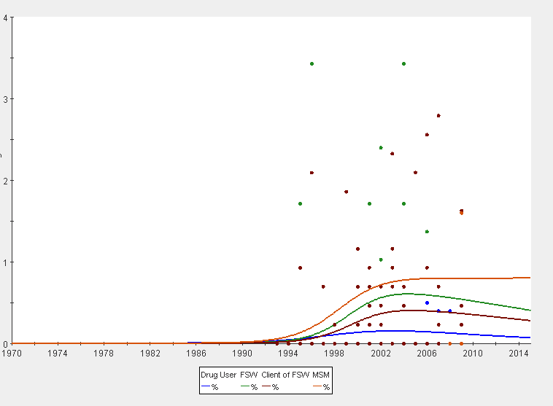
HIV PREVALENCE AMONG HIGH-RISK SUBGROUPS
Percentage
MSM
FSW
Clients of FSW
Drug users

Slide 13
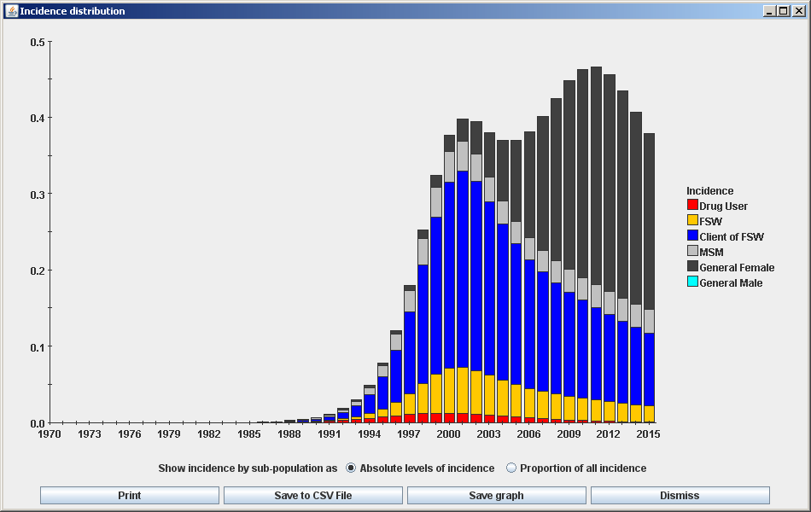
HIV INCIDENCE IN POPULATION SUBGROUPS
New infections ( Thousands)

Slide 14
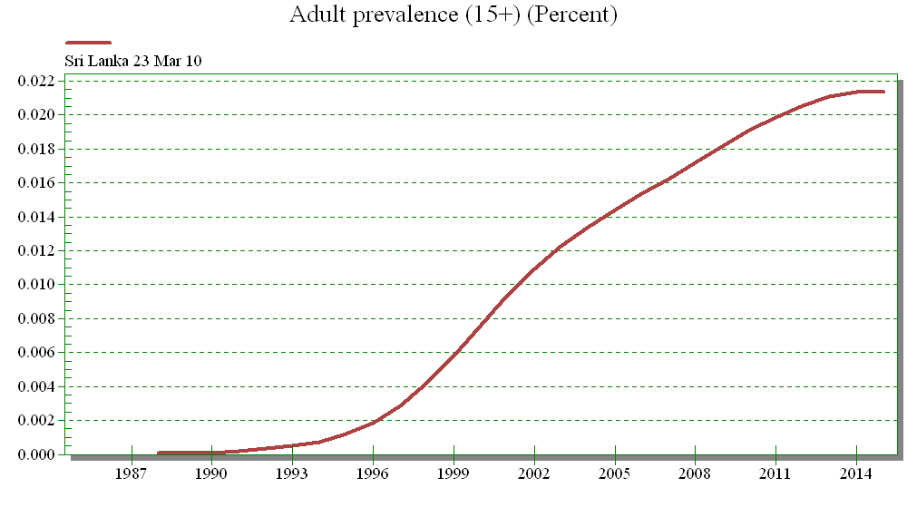
TRENDS IN ADULT HIV PREVALENCE (15+)
Current HIV prevalence
Peak around 2012
Percentage

Slide 15
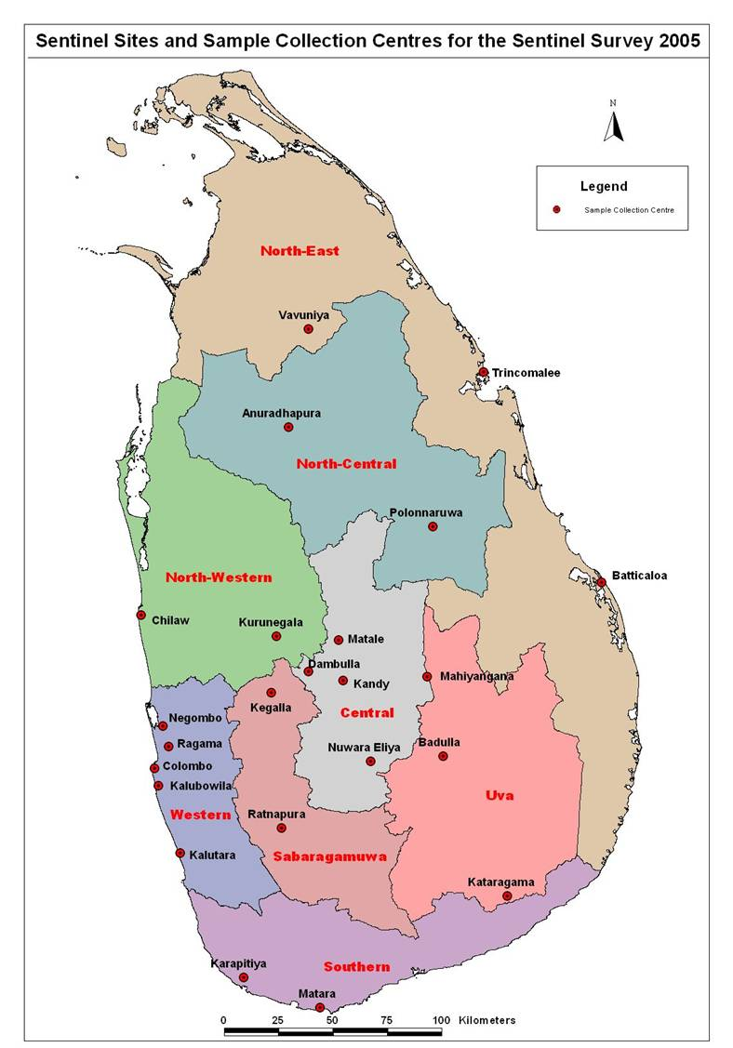
HIV SENTINEL SURVEY

Slide 16
HIV PREVALENCE AMONG
FEMALE SEX WORKERS
HIV PREVELANCE %
SOURCE: NSACP /SENTINEL SUVEILLANCE DATA

Slide 17
HIV PREVALENCE AMONG
MSM
HIV PREVELANCE %
SOURCE: NSACP /SENTINEL SUVEILLANCE DATA

Slide 18
HIV PREVALENCE AMONG
STD CLINIC ATTENDEES
HIV PREVELANCE %
SOURCE: NSACP /SENTINEL SUVEILLANCE DATA

Slide 19
HIV PREVALENCE AMONG
TUBERCULOSIS PATIENTS
HIV PREVELANCE %
SOURCE: NSACP /SENTINEL SUVEILLANCE DATA

Slide 20
ANTENATAL HIV TESTING
Year | Number tested | Number positive | %
2000 | 30,906 | 3 | 0.01
2001 | 20,409 | 0 | 0
2002 | 17,601 | 0 | 0
2003 | 20,286 | 1 | 0.01
2004 | 14,529 | 2 | 0.01
2005 | 14,476 | 0 | 0
2006 | 13,225 | 0 | 0
2007 | 8,648 | 1 | 0.01
2008 | 12,239 | 3 | 0.02
2009 | 11,216 | 2 | 0.02

Slide 21
HIV TESTING IN FORMER WAR AFFECTED AREAS
ANC MOTHERS(2009 - 2010 up to June)
District | Number of HIV tested | Number positive | Prevalence rate %
Vauniya | 840 | 0 | 0
Mullaitivu | 101 | 0 | 0
Kilinochchi | 99 | 0 | 0

Slide 22
HIV AND BLOOD TRANSFUSION
HIV screening commenced in 1987
No Blood transfusion related HIV infection reported since year 2000
So far 3 cases of transfusion related HIV infections reported (0.4% of all HIV cases)

Slide 23
PERCENT OF VOLUNTARY VS. REPLACEMENT BLOOD DONATIONS
SOURCE: NATIONAL BLOOD TRANSFUSION SERVICE

Slide 24
HIV PREVALENCE IN DONATED BLOOD
% HIV PREVALENCE
SOURCE: NATIONAL BLOOD TRANSFUSION SERVICE

Slide 25
HEP B & C IN DONATED BLOOD

Slide 26
DATA ON HIV CASE REPORTING

Slide 27
CUMULATIVE REPORTED HIV CASES
AS OF END 2009
  1196 HIV infections (309 in AIDS stage)
  202 Deaths
  43 Children (Mother to child transmission)
  During first 9 months in 2010 – 89 cases

Slide 28
REPORTED NUMBER OF HIV CASES
In 2000 54 per year

Slide 29
MALE : FEMALE RATIO
1.6 : 1
1.2 : 1
1.5 : 1

Slide 30
CUMULATIVE HIV CASES BY AGE AND SEX AS OF END 2009 (N=1141)
80 %
6 %
10 %
4 %
0.4 %
(Age group % out of the total cases)

Slide 31
NEW HIV CASES BY AGE AND SEX
IN 2009
72 %
15 %
7 %
5 %
0 %
(Age group % out of the total cases)

Slide 32
Cumulative HIV Cases by Mode of Transmission as of end 2009 (N=802, 67%)

Slide 33
NEW HIV CASES BY MODE OF TRANSMISSION IN 2009 (N=77, 56%)

Slide 34
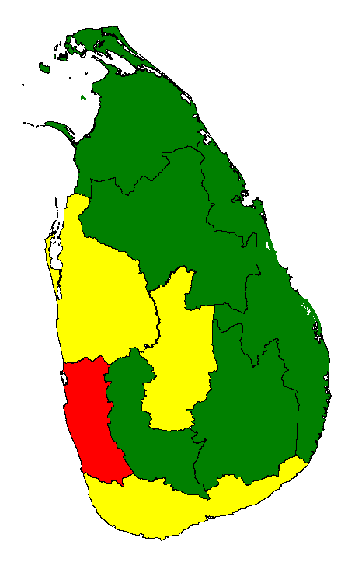
Cumulative HIV Cases by Province
as of end 2009 (N=1196)

Slide 35
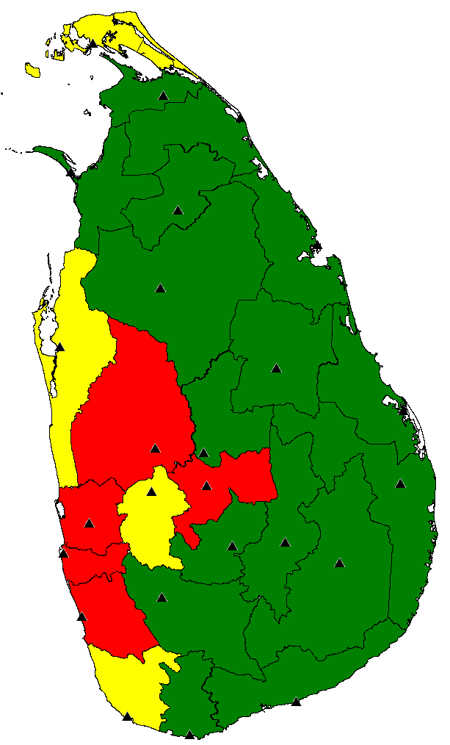
% of New HIV Cases by District in 2009

Slide 36
Sexually Transmitted Infections

Slide 37
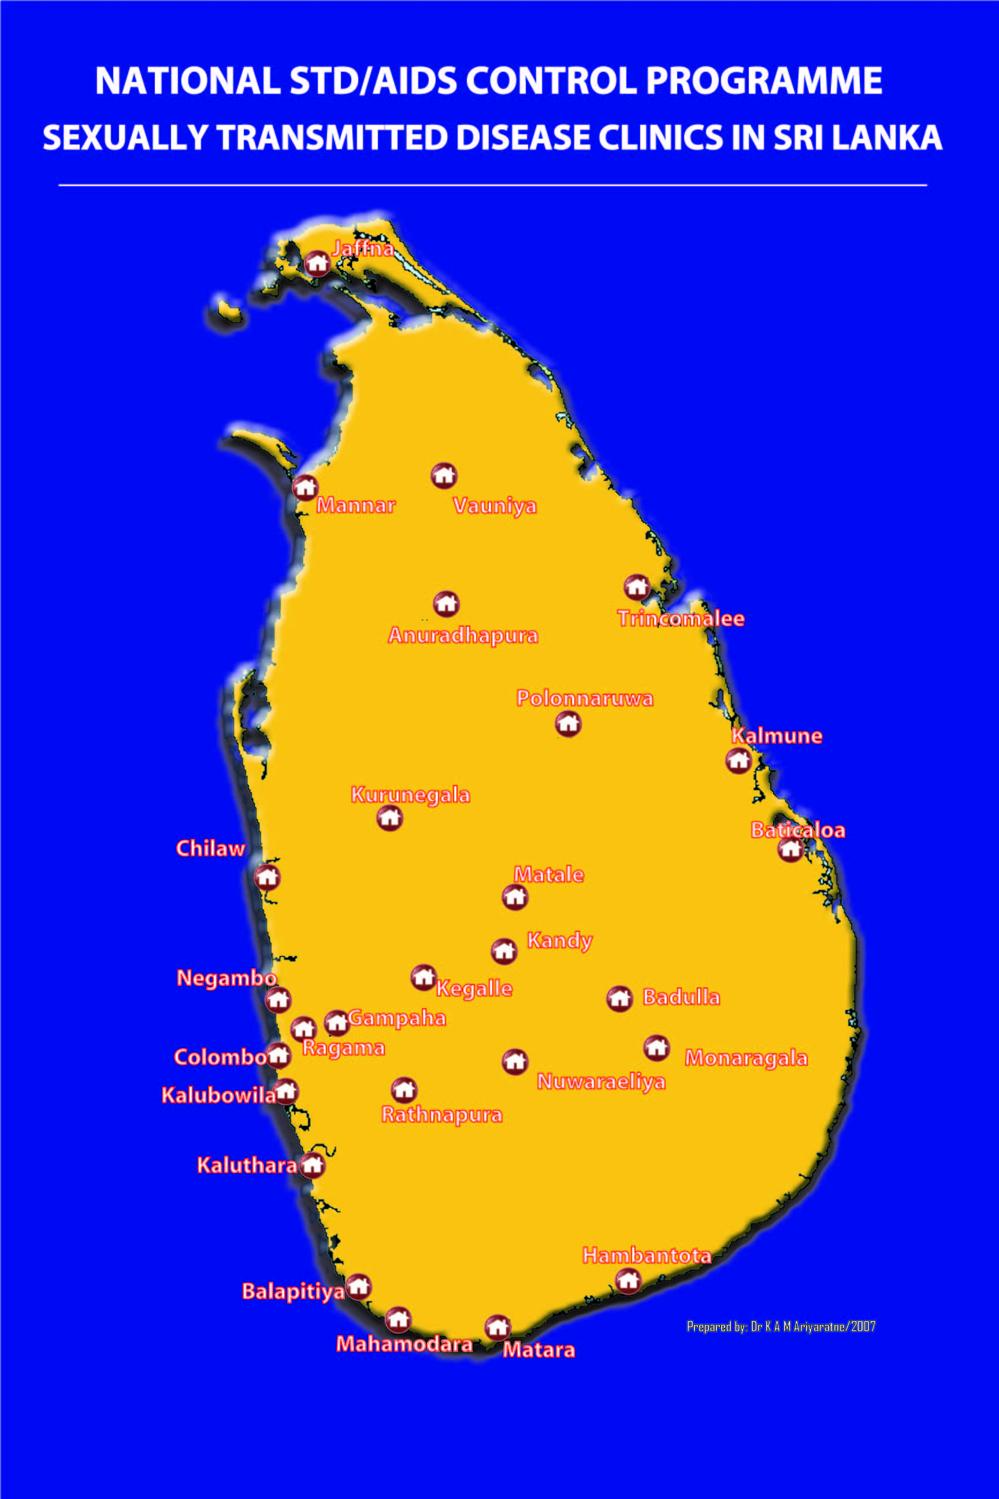

Slide 38
TRENDS OF BACTERIAL STIs
Non gonococcal Infections

Slide 39
TRENDS OF VIRAL STIs
Genital Herpes

Slide 40
PERCENTAGES OF REPORTED STI CASES IN 2009

Slide 41
NUMBER OF REPORTED STI CASES IN 2009

Slide 42
ANTIBIOTIC RESISTANCE PATTERN
OF N. gonorrhoeae (N= 220-260)

Slide 43
ANTIBIOTIC RESISTANCE PATTERN
OF N. gonorrhoeae (N= 220-260)
 | Cefuroxime | Ceftriaxone | Spectinomycin
2001 | 3.4% | 0 | 0
2002 | 4.2% | 0 | 0
2003 | 0 | 0 | 0
2004 | 0 | 0 | 0
2005 | 0 | 0 | 0
2006 | 0 | 0 | 0
2007 | 0 | 0 | 0
2008 | 0 | 0 | 0
2009 | 1.3% | 0 | 0

Slide 44
PERCENTAGE OF PREGNANT WOMEN SCREENED
FOR SYPHILIS (2005 - 2009)
year | Pregnant Mothers Registered | Pregnant Mothers tested for VDRL | Percent
2006 | 385,205 | 139,991 | 36%
2007 | 404,138 | 295,038 | 73%
2008 | 397,527 | 307,213 | 77%
2009 | 381,406 | 307,482 | 81%
Source: Annual report on family health Sri Lanka, 2005, Family Health Bureau

Slide 45
ANTENATAL VDRL POSITIVITY RATE
PERCENTAGE OF VDRL POSITIVITY RATE
Source: FHB

Slide 46
SYPHILIS IN FORMER WAR AFFECTED AREAS
ANC MOTHERS (2009 - 2010 up to June)
District | VDRL tested | VDRL positive | TPPA Positive | Prevalence
Vauniya | 6,700 | 29 | 1 | 0.02%
Mullaitivu | 175 | 2 | 0 | 0
Kilinochchi | 104 | 1 | 0 | 0

Slide 47
COMMUNITY STI PREVALENCE SURVEYS
Study | STI | Prevalence (CI)
Low socioeconomic community women – Colombo -2007 | Chlamydia | 0.6% (0.04 - 1.16)
 | Trichomonasis | 0.6% (0.04 - 1.16)
 | Gonorrhoea | 0%
Community survey in Rathnapura - 2008 | Chlamydia | 2.1 (1.2 - 3.6)
 | Trichomonasis | 1% (0.5 - 2)
 | Gonorrhoea | 0%
Source: ¹ Hemachandra N, Rajapaksha L , ² Herath S, Samarakoon S, Fonseka P, ³ Herath S, , Fernando D, Jayasinghe S^{. 4} Herath S, Dewanarayana A, Senawirtne P

Slide 48
SUMMARY
Sri Lanka continues to indicate low prevalence
Sizable vulnerable populations, Migration, Changing socio-economic situation can be Challenging
Low injecting drug use
Low sexual concurrency
High literacy rate
Favourable socio-cultural norms

