Slide 1

Dr Don Ajith Karawita
MBBS, PgD Ven, MD Venereology
National STD/AIDS Control Programme.

Slide 2


Slide 3
VCT
Case finding strategy in HIV. (Active/Passive)
Service package.
It is the entry point to HIV care and treatment. (especially early in the disease process before they become symptomatic)
It is a place for behaviour change communication.
What is the OPD situation in a hospital?

Slide 4
HIV testing
Mandatory (blood safety, tissue/organ transplants etc)
Screening for diagnostic workups
HIV surveillance (unlinked anonymous testing)
Voluntary (VCT)
Provider Initiated Testing (PIT)
Legal requirement ?

Slide 5
Service delivery settings
Free standing
Mobile/Outreach
Institutional/Integrated
  STI clinics
  General health system (MOH, ANC, OPD)
  Prison
  Drug and Alcohol services
  Gay and Lesbian health services.

Slide 6
Concept of VCT

Slide 7


Overview of the clinical disease
AIDS
Clinical stage 4
AIDS Defining illnesses
HIV Seroconversion illness
Clinical stage 3
75%
Clinical stage 2
33%
Clinical stage 1
1-4wks
3wks
8 to 12 years

Slide 8
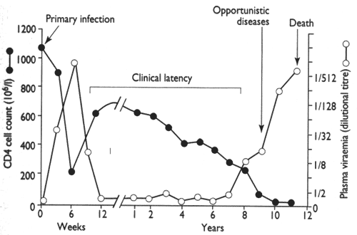

Slide 9
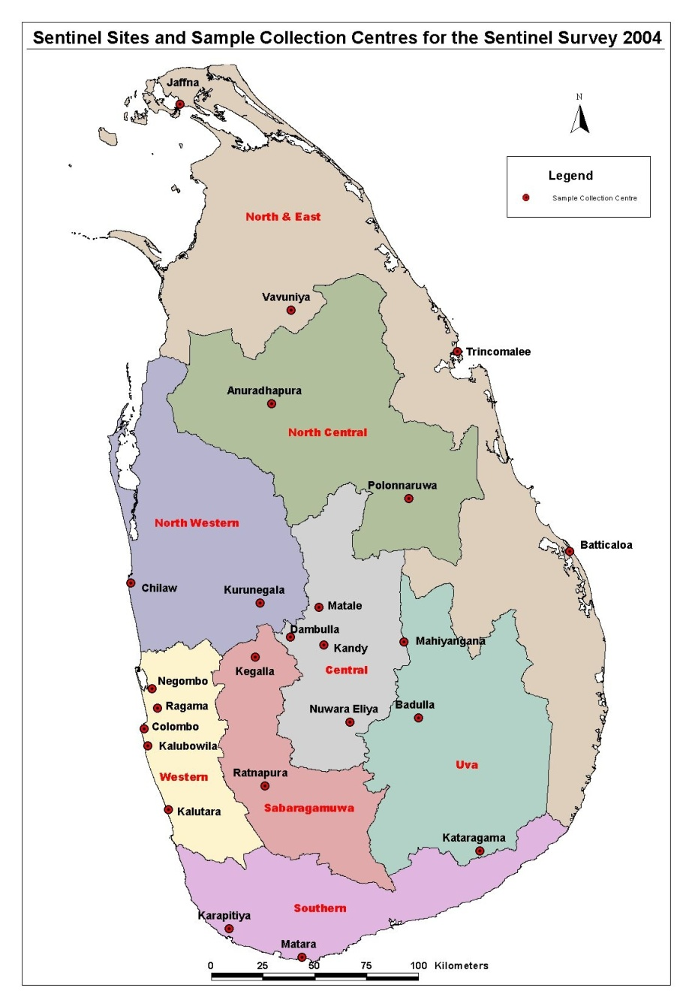


Iceberg phenomenon of disease
Mass of unrecognized disease in the community
Hidden mass of diseases
1. Sub clinical cases
2. Carriers
3. Undiagnosed cases

Slide 10
Case finding strategies
Active case finding.
Passive case finding.
Case finding tools
  Screening
Social marketing
Application
  Population
  Sub-population
  Geographic area

Slide 11
Concept of “Lead time”
Outcome achieved by early detection
Disease onset
Screening time
1st possible detection
B
Multiple critical points
A
Final critical point
Usual time of diagnosis
Usual outcome
Lead time- Period between diagnosis by early detection and diagnosis by other means)
Time lag between disease onset and usual time of diagnosis
Notes:
There are usually a number of critical points which determine both the severity of the disease and the success of any treatment in reversing the disease process.
There is clearly little value in detecting disease in advance of the usual time of diagnosis unless such detection precedes the final critical point beyond which treatment would be unsuccessful and / or permanent damage would be done.
Detection programmes should therefore concentrate on those conditions where the time lag between the disease’s onset and its critical point is sufficiently long to be suitable for population screening.
Lead time is the advantage gained by screening.

Slide 12
Criteria for screening
Condition Related
Important health problem (prevalence should be high)
Recognizable latent or early asymptomatic stage.
Natural history of the condition should be well known.
There should be a test
Facilities should be available to confirm the disease
Effective treatment should be there
Test Related
Availability of a suitable test
Acceptable to the population
Economical
Repeatability

Slide 13
Screening
Benefits of screening
Reassurance from a correct negative test.
Disease prognosis can be improved.
Disease morbidity can be reduced.
Quality of life can be improved.
Reduced resources needed for treatment.
Possible adverse effects associated with screening
Morbidity associated with the test itself.
Prolong period of morbidity with early diagnosis.
Diagnosis of pseudo disease and over treatment
False reassurance form a false negative test.
Anxiety and morbidity associated with a the false positive test
Diverting resources from other services.

Slide 14
Reasons to provide HIV counseling and testing (VCT)

Slide 15
Reasons to provide HIV counseling and testing
Clinical risk assessment and realistic feed back
HIV prevention counselling  Is effective at
  Reducing risky behaviours in HIV-infected and uninfected persons (Behaviour change communication).
  Behaviour development communication.

Slide 16
Reasons to provide HIV counseling and testing
3. Provision of HIV/AIDS related knowledge.
4. Knowledge of HIV status can benefit HIV-infected persons.
  Treat and prevent opportunistic infections.
  Prevent MTCT.
  Reduce the risk of transmission to others
  Help plan for future.
  Provide access to antiretroviral therapies as these become available.
  Provision of access to support groups.
    Financial/ economical
    Psychological
    Nutritional

Slide 17
UN policy states that
HIV-voluntary testing includes
Pre- HIV test counseling
Post-test counseling

Slide 18
Pre- HIV test counseling

Slide 19
Pre- HIV test counseling
  Greeting, Introduction and Orientation. Demographic data collection, How did you learn about the site (important for VCT social marketing)
  Reason for visit/client’s need – HIV related issues/ other issues
  Inform the confidentiality of the process.
  Prepare the client for the HIV test and the provision of informed consent.
  Clinical risk assessment and realistic feed back.
  Provision of HIV/AIDS related knowledge.

Slide 20
Pre- HIV test counseling
  7. Behaviour change communication
    HIV prevention education and counseling  is effective at
      Reducing risky behaviours in HIV-infected and uninfected persons .
    Personal risk reduction plan (risk reduction model, risk elimination model, harm reduction model)
  8. Explaining the implication of knowing sero-status (positive, negative or inconclusive)
  9. Assess the individual’s coping strategies and psychosocial support available/system.

Slide 21
Post-test counseling

Slide 22
Post test counseling
  Negative test counseling.
  Indeterminate test counseling.( repeat in 2wks, 6months, 1 year. Inconclusive report after 1 year counsel as negative report))
  Positive test counseling.
    Assess the psychological preparedness to get the result
    Helping to cope with stressors
    Treat and prevent opportunistic infections.
    Prevent MTCT.
    Reduce the risk of transmission to others
    Help plan for future.
    Provide access to antiretroviral therapies as these become available.
    Provision of access to support groups.
      Financial/ economical
      Psychological
      Nutritional

Slide 23
Post test counseling - Overview
  Prepare the client for the result
  Helps the client to understand and cope with the HIV test result
  Provides the client with any further information required
  Referring the client to other services
  Further discuss strategies to reduce HIV transmission
  forms of post-HIV test counseling session depends on what the result is.

Slide 24
Forms of post-test counseling
HIV positive test counseling | HIV negative test counseling | Inconclusive test counseling
Cross-check all results prior to counseling session | Cross-check all results prior to counseling session | Cross-check all results prior to counseling session
Assessment of psychological preparedness/support +++ | Assessment of psychological preparedness/support + | Assessment of psychological preparedness/support ++
Provide results to the client in person, direct and clearly Explain the Meaning of positive test | Provide results to the client in person, direct and clearly Explain the Meaning of Negative test (you are safe for exposures before the window period) | Provide results to the client in person, direct and clearly Explain the Meaning of inconclusive test
Behaviour change communication | Reinforce Behaviour change communication | Reinforce Behaviour change communication
Discuss care and support services available | Other issues – Frequent testers, worried wells, Anxiety issues, Feeling of false immunity

Slide 25
VCT in special situations
Mobile populations
Prison
Sexual assault
Occupational exposure
IDU
Sex workers
Youth and children
MSM
PMTCT
ANC

Slide 26

Steps in problem solving
  Describe the problem
  Brainstorm for options
  Critically evaluate self-talk about options
  Client chooses
  Develop a plan of action
  Facilitate the development of skills and strategies

Slide 27
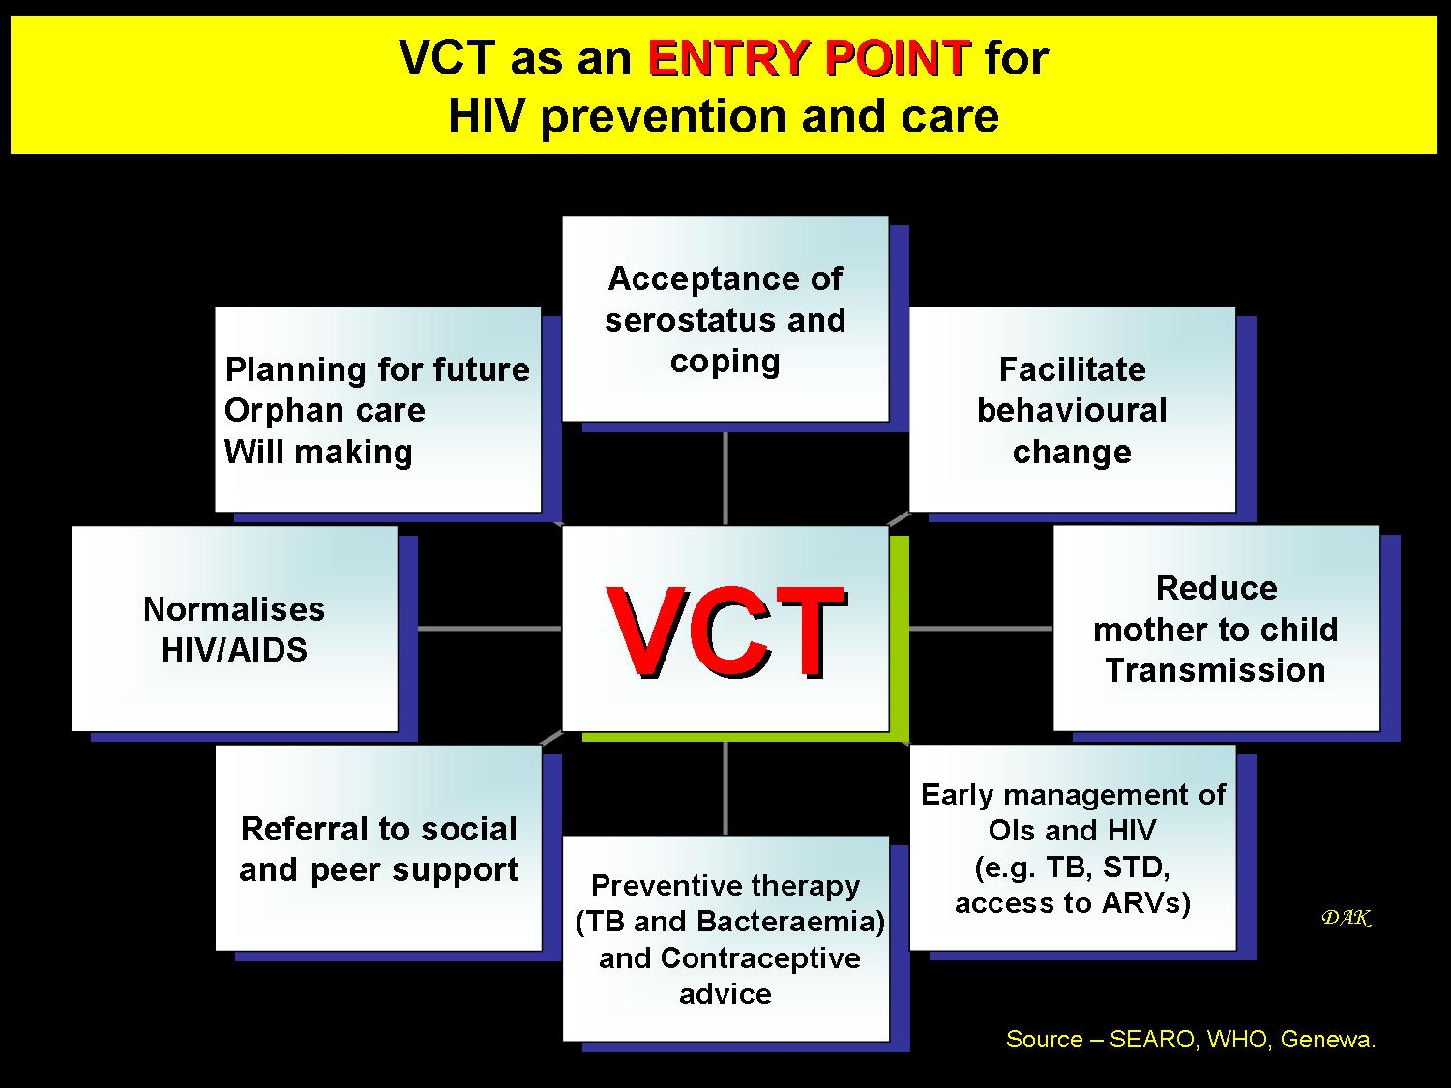

Slide 28


